Slide 1
INSERT, UPDATE and DELETE statements
Maziar Shajari
Revised: Feb 2020

Slide 2
CRUD Operation
Within computer programming, the acronym CRUD stands for create, read, update and delete. These are the four basic functions of persistent storage.
Create
Read
Update
Delete

Slide 3
The SQL INSERT INTO Statement
The INSERT INTO statement is used to insert new records in a table.
INSERT INTO Syntax
It is possible to write the INSERT INTO statement in two ways.
The first way specifies both the column names and the values to be inserted:
Use Subqueries ;
INSERT INTO Sales (ProductID ,Price ,SalesDate , EmpID)
VALUES (733, 356.898, GETDATE(), 17 );
SELECT *
FROM Sales
ORDER BY SalesID DESC;
What about the salesID?
There is no salesID in the column’s list.

Slide 4
The SQL INSERT INTO Statement
The first way :
You can omit the column list if you provide data for all columns in their exact order in the table:
INSERT INTO Sales
VALUES (733, 356.898, GETDATE(),15);
If you miss a value, you’ll get an error –“insufficient number of values”.

Slide 5
INSERT with partial sets of values
If you attempt to INSERT only some of the values, you need to specify the column list for the values being supplied:
INSERT INTO Sales (ProductID ,Price , EmpID)
VALUES (733, 356.898, 16 );
What happened to the sales date?
SELECT *
FROM Sales
ORDER BY SalesID DESC;

Slide 6
IDENTITY and INSERT
Our sample Subquery database uses application-generated “surrogate” keys.
A surrogate key is an artificial identifier used to uniquely identify a business object.
Surrogate keys are typically used as the primary key for a table.
کلید جایگزین

Slide 7
IDENTITY and INSERT
Surrogate keys are often automatically generated by the database management system.
Most efficient way of generating identifiers that are guaranteed to be unique:
In Microsoft SQL Server, an IDENTITY column specifies an automatically-generated unique value
Must be numeric; no built-in support for generating alphanumeric keys
Usually one omits the surrogate key from INSERT statements
This behaviour can be overridden using the SET IDENTITY_INSERT statement.

Slide 8
INSERT FROM SELECT
You can also INSERT into a table values that come from a SELECT statement:
INSERT INTO Test (x, y, z)
SELECT ot.x, ot.y, at.z
FROM othertest AS ot
INNER JOIN anothertest AS at
ON (ot.x = at.x)
WHERE at.z LIKE ‘%This is a test pattern%’

Slide 9
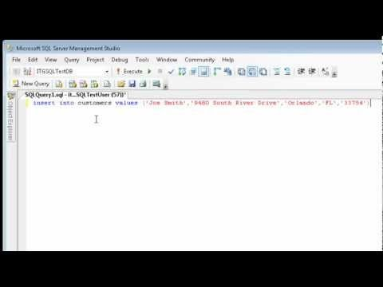
The SQL INSERT INTO Statement

Slide 10
UPDATE statement syntax
UPDATE table
SET column1 = value1,
column2 = value2
WHERE …
Note that the UPDATE statement may SET the same columns as those referenced in the statement’s WHERE clause.
The set of rows to be updated is computed first, prior to any modifications being made.
Update statements are atomic; either they modify all of the intended rows correctly, or the entire statement is undone.

Slide 11
UPDATE statement syntax
You can update one or more columns in an UPDATE statement:
UPDATE Sales
set EmpID = 15
where SalesID = 54;
Your SalesID might be different.
Check it first. We want to change the last row in the sales’s table.
Warning
For the next UPDATE and DELETE statements, always remember to code a WHERE clause. Otherwise every row in the table will be modified or deleted.

Slide 12
UPDATE statement syntax
Update MULTIPLE rows:
/* 1- Update several rows */
UPDATE Sales
set EmpID = 33
where EmpID = 15;
/* (4 row(s) affected) */
/* 2- Update several rows */
UPDATE Sales
set EmpID = 15
where EmpID = 33;
/* (4 row(s) affected) */

Slide 13
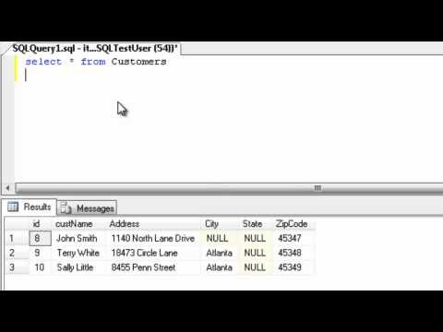
The SQL UPDATE Statement

Slide 14
DELETE STATEMENTS
You can delete one or more rows with a single DELETE statement:
DELETE FROM Sales
WHERE SalesID >50;
If you omit the WHERE clause, all rows in the table will be deleted!

Slide 15
TRUNCATE TABLE statement
Many database products and the ISO SQL Standard includes a statement, TRUNCATE, that specifically deletes every row in a table.
Use TRUNCATE if deleting the entire table is desirable
TRUNCATE is usually faster than DELETE.
Implementation of TRUNCATE is designed for efficiency.
Example:
TRUNCATE TABLE Test
DELETE is logged and can be rolled back;
TRUNCATE is not logged and cannot be rolled back.

Slide 16
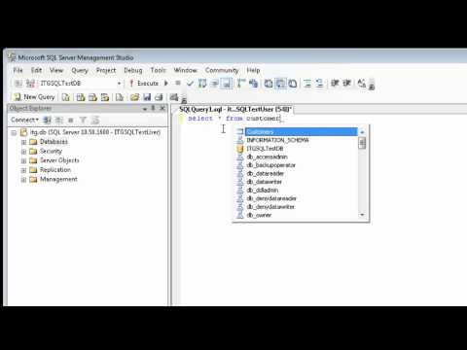
The SQL DELETE Statement

